Slide 7
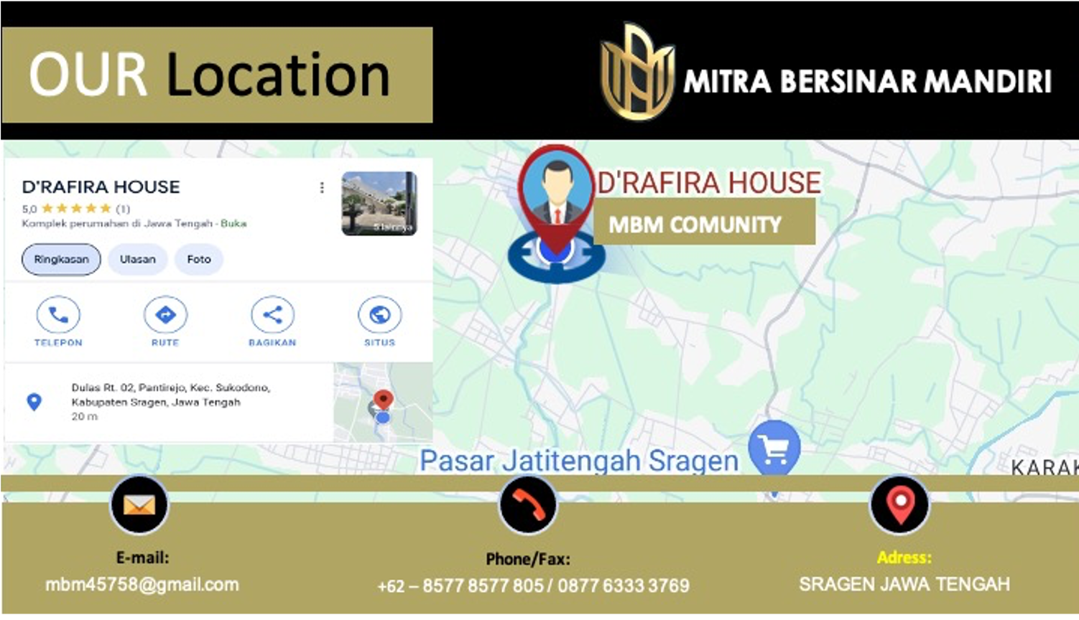

Slide 36
Thank
Let’s Go for JOIN US
YOU

